Slide 1

Turtle Games
Analysis Report
By Cynthia Arshy

Slide 2
Turtle Games Turtle Games, a global games manufacturer and retailer Their business objective is to improve overall sales performance
Predicting Lego price with regression analysis
Sentiment & reviews
Customer group or segmentation
Overview past sale trends
Predict next year sales

Slide 3
Intro
Turtle Games, a global games manufacturer and retailer
Their business objective is to improve overall sales performance
PART 1
Determine the optimal price at which they should sell a variety of their various products
By measuring the linear regression, I tested the data in a sample population and found that that the correlation between Price and the pieces sold is correlated (0.09) meaning that the amount of pieces is not an influence on the sales price.
I analysed optimal price for 8000 Lego pieces, and the predicted price with linear regression model suggests between 781-784 regardless the age group. After performing a linear regression the recommended prices

Slide 4
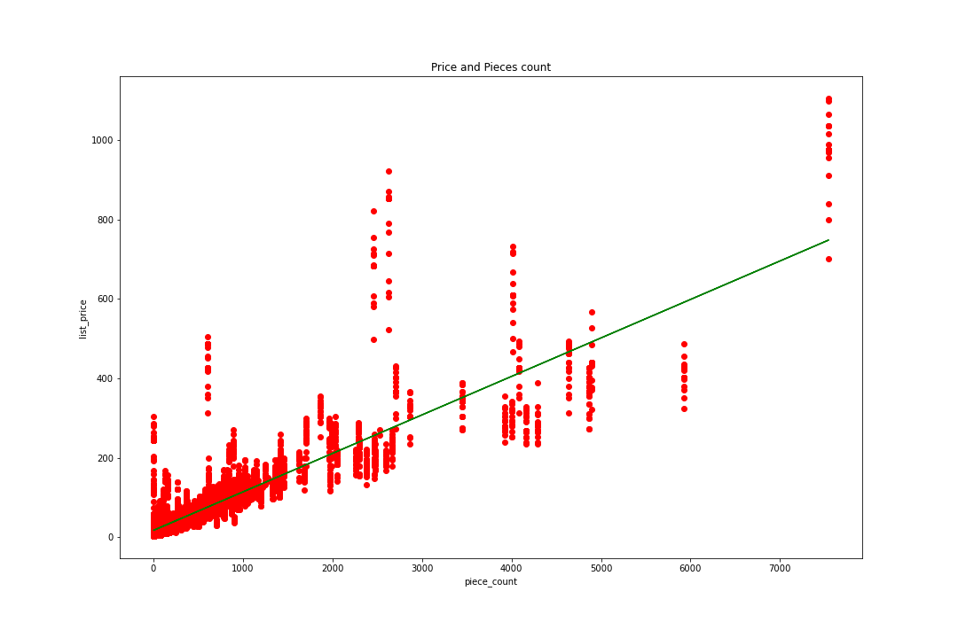
Linear regression
Lego prices and pieces count
Regression graph

Slide 5
Part 2: Sentiment Analysis
Customer’s reviews for toys and games from its e-commerce site.
Finding out, what is the general sentiment of customers across all products and
Check on the polarity shown by the top 20 most positive and negative reviews.

Slide 6
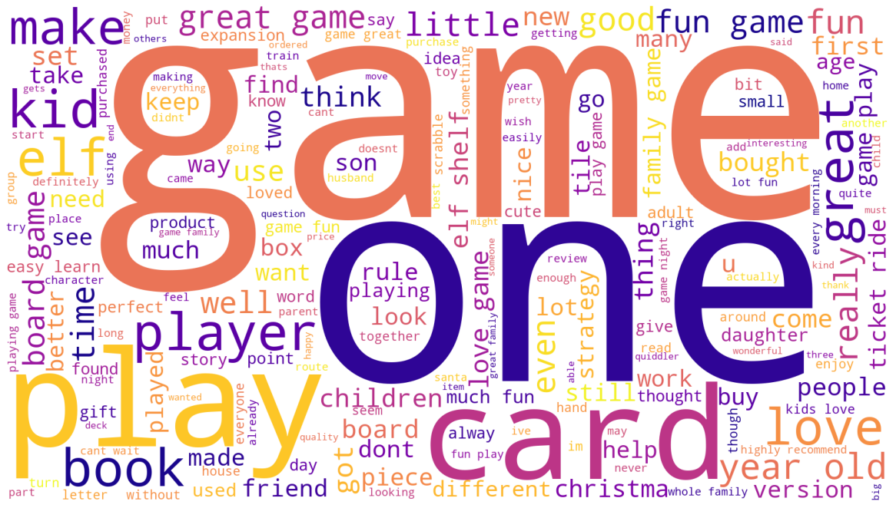
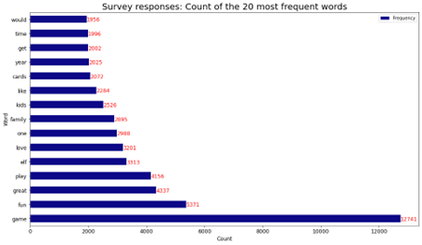
Word Cloud
Customer’

Slide 7
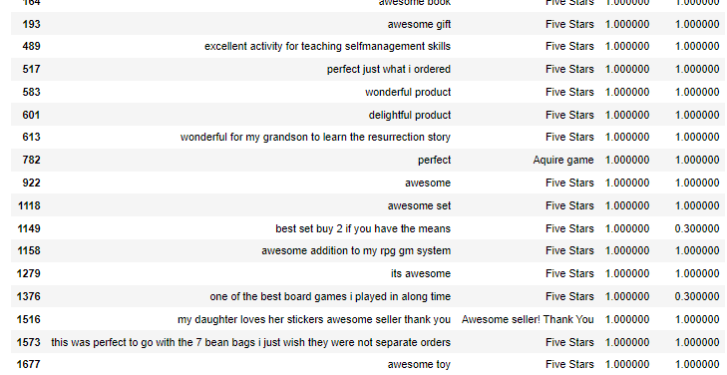

Slide 8
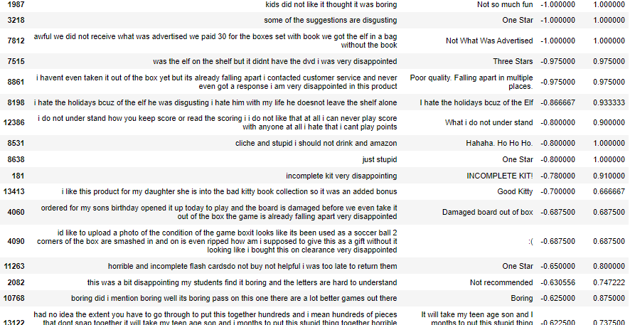

Slide 9
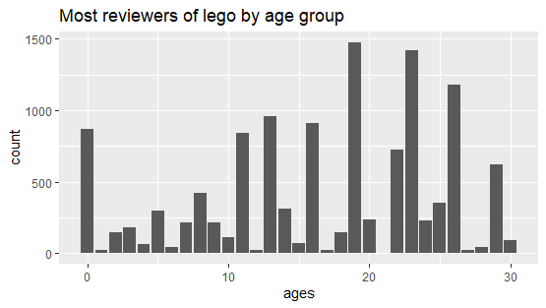
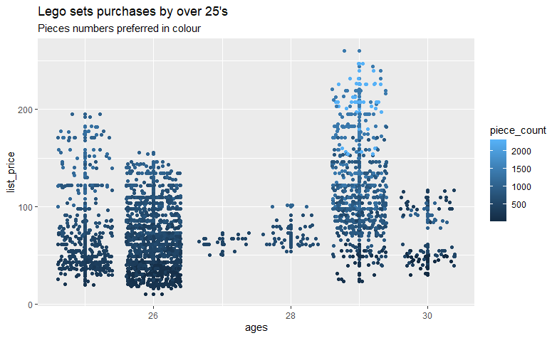
Part 3: Customers Group
Reviews
Buyers’ age, pieces and prices

Slide 10
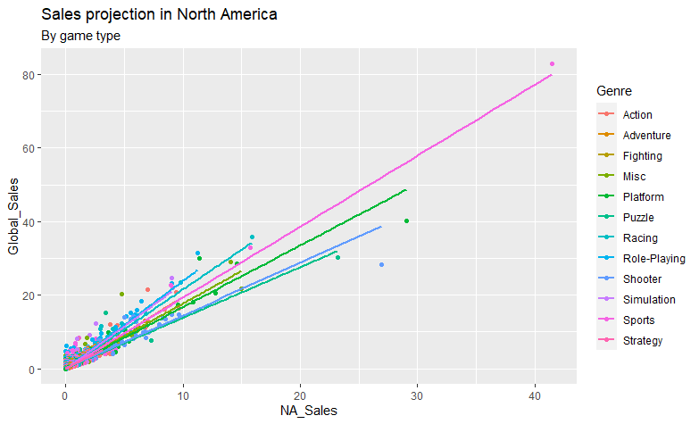
Sales trends
North America and Global Sales correlation is 0.94, suggesting a strong positive correlation (nearly 1), meaning that the two variables influence, depend on each other.
The games sales by genre graphs show by sort of games are the most sold.
The data doesn’t specify if they if total sales are from 1980 to date, it only says when the first game was released in 1980, hence I can’t give you a Global Sales statistics due to not having a starting measuring point.

Slide 11
Conclusion
Regression result for 8000 pieces Lego optimal prices $781-$784
Target audience for sales 29 years old.
Target audience for reviews 11, 13, 16, 19 and 23 years old
Predicted sales price for next financial year of the best seller product is $5.73 Million

